Slide 1
Classwork
Description: ClassWork is an app that combines features from google docs, slack and zoom all into one application.
This is the first page the user see’s when they open the application. They can sign into their account, register for an account or find their school.
Sign In
Register
Find School

Slide 2
Classwork
Easy login system that just asks the user for their username and password.
Username:
Password:
Sign In

Slide 3
Classwork
Classwork asks user for their phone number in order to have a three-step verification system in place. If the user wishes to change account password, username, etc. We will ask them to confirm their email, username, and phone number.
Name:
Email:
Phone Number:
Username:
Password:
Register

Slide 4
Classwork
The user can search for their school so they can keep a close eye on the Universities activity.
City:
State:
Zip Code:
County:
Find School

Slide 5



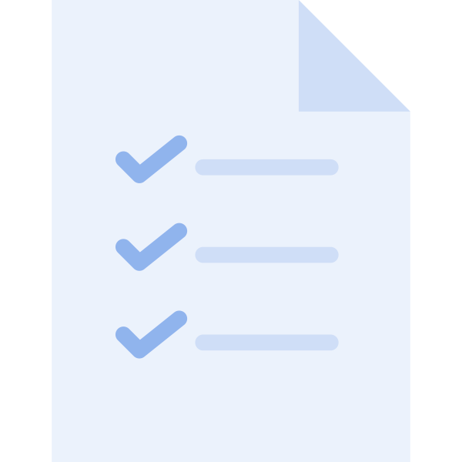

Classwork
This shows the users account page. They can view the homeroom, workroom, division and conference feature.
Homeroom
Workroom
Division
Conference
Calendar
Tasks
Settings

Slide 6





Homeroom
In homeroom, the user can msg another student that is working with them on a project for a certain class and upload any important documents.
Example
Example
Send Message

Slide 7

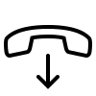

The division feature allows a user call his/her project partner. The user can have multiple project partners on the line just like zoom.
Division
Emily
Decline
Accept

Slide 8



Division
Here we can see how the user is on a virtual call with his project partner. This feature is like Apple’s facetime.
Emily
End Call

Slide 9



Conference
The conference section holds the users contacts. Contacts change when the user changes their school subject.
Contacts
Emily
Brad
Carlos
Jennifer
Carly

Slide 10
Conference
Emily

Slide 11
The workroom feature lets a user load a group that he/she is apart and upload or download important documents, pdf, ppt, etc.
Workroom
Groups
English 1101
Chemistry
Intro to IT

Slide 12



Workroom
This is an example of what the user's group might look like once the user loads into a group of their choice.
English 1101
Story.doc
Story.doc
Story.doc

